Slide 1

Supply Chain
CLS CAI3_DAT2_G4
Team 04

Slide 2

Table of Contain
Introduction & Project Overview
Requirements & Methodology
Project Phases
Conclusion
Q & A

Slide 3
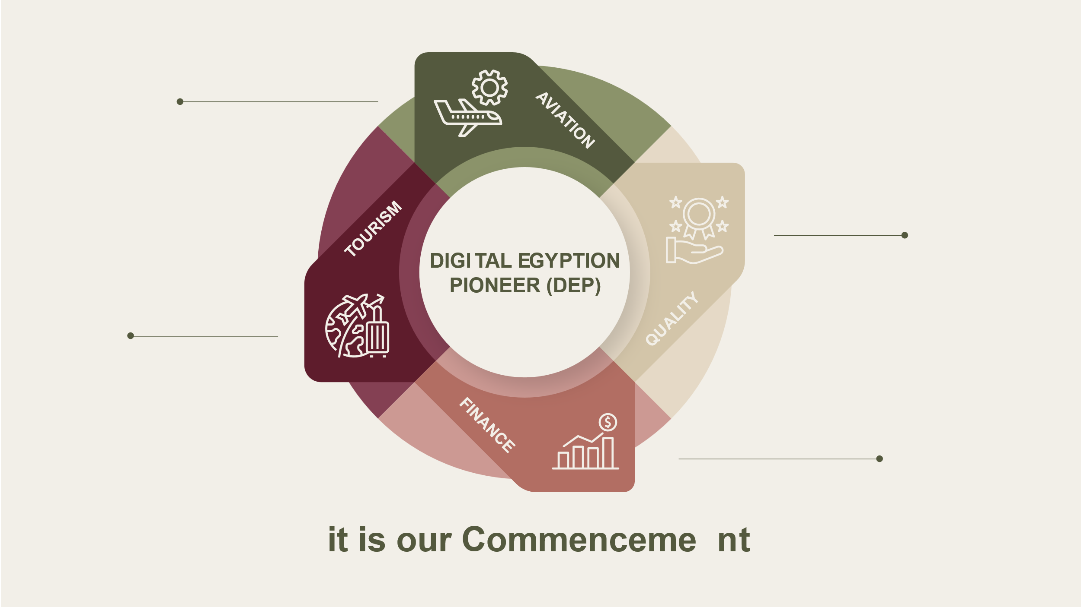
Karam Mohamed
Amr Gamal
Doaa Mohamed
Mohamed Khaled
It is our Commencement

Slide 4
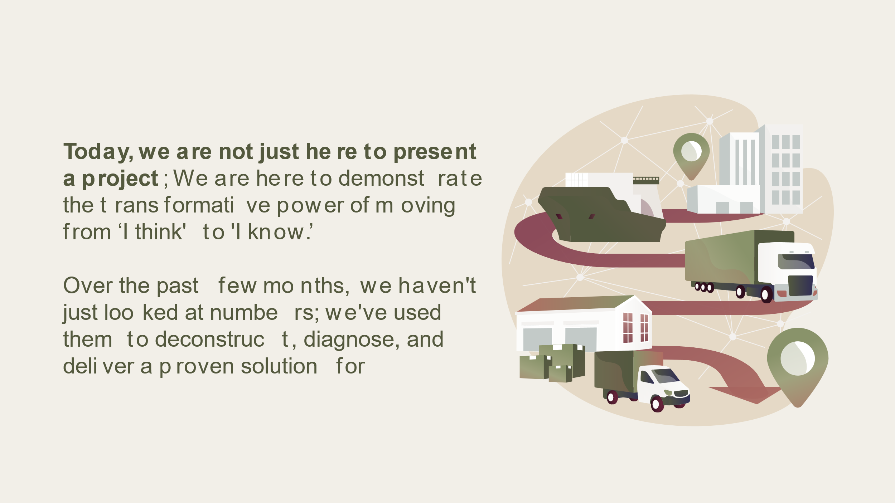
Today, we are not just here to present a project; We are here to demonstrate the transformative power of moving from ‘I think' to 'I know.’
Over the past few months, we haven't just looked at numbers; we've used them to analyze, diagnose, and deliver a proven solution for

Slide 5
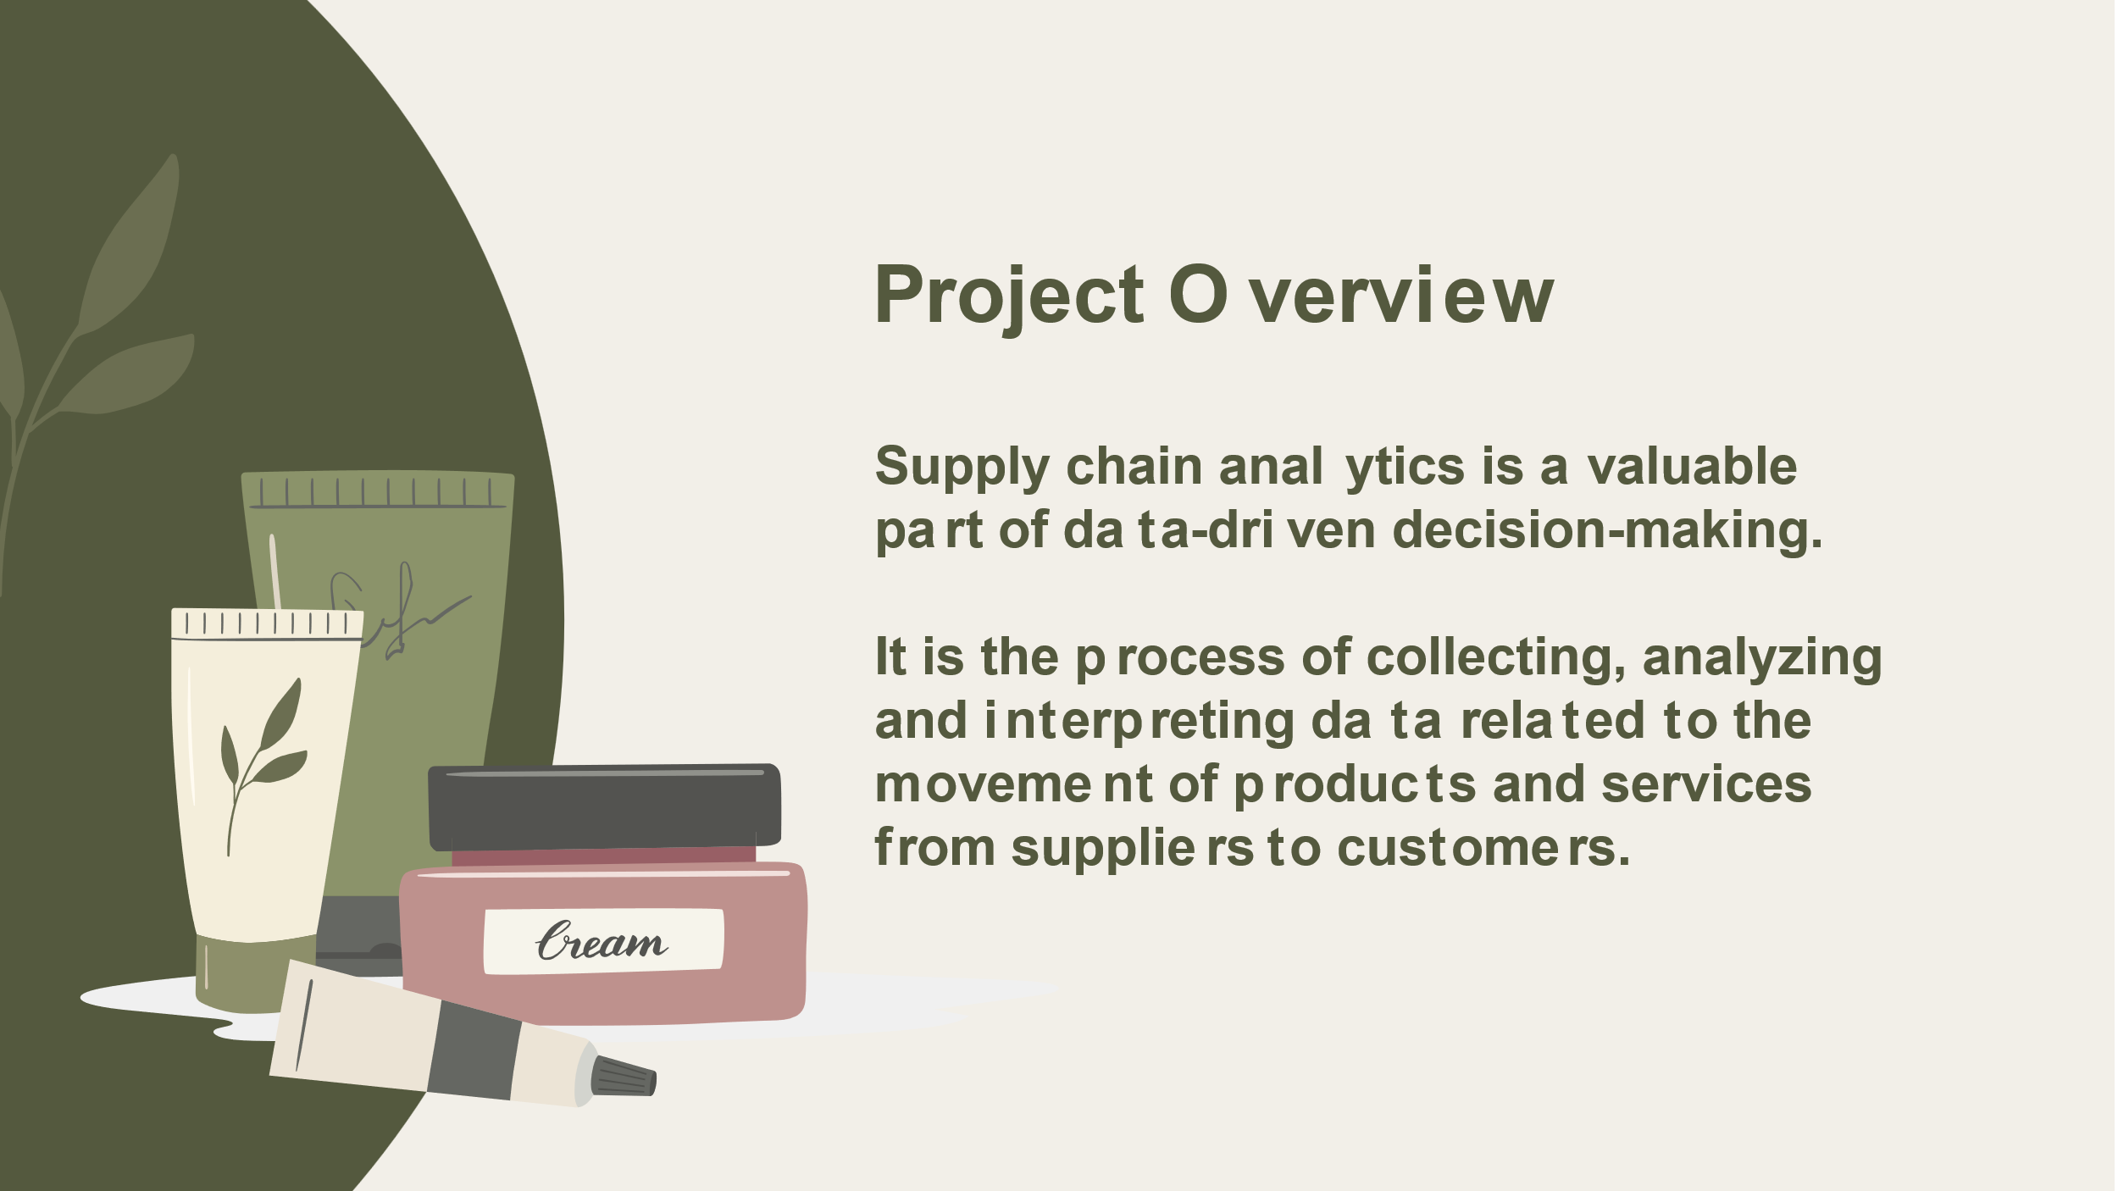
Project Overview
A Supply Chain suffer from increased inventory holding costs and negatively impacts the overall service levels.
To address this, our strategic solution involves a targeted analysis of the products, suppliers, and shipping timelines, with the goal of eliminating inefficiencies, achieving solid cost reductions, and significantly improving both product availability and service consistency.

Slide 6
Requirements
KPIs
Product Performance
Quality
Financial

Slide 7
Methodology applied
Exploratory Data
Correlation Analysis
The Root Cause & Diagnose

Slide 8

Dataset Summary
Manufacturing
Manufacturing cost
Production volumes
Manufacturing lead time
Inspection results
Defect rates
Operations
Stock levels
Availability
SKU performance
Order quantities
Distribution
Transportation modes (Road, Rail, Air)
Routes
Costs
Lead times
Locations (Mumbai, etc.)
Notes:
Upstream (Manufacturing & Production)
Midstream (Inventory & Operations):
Downstream (Distribution & Transport):

Slide 9
Project Phases
Screen the data.
ETL the data.
Build the Data Model - DAX
KPIs and data Analysis.
Insights & improvement recommendations
Notes:
Upstream (Manufacturing & Production)
Midstream (Inventory & Operations):
Downstream (Distribution & Transport):

Slide 10

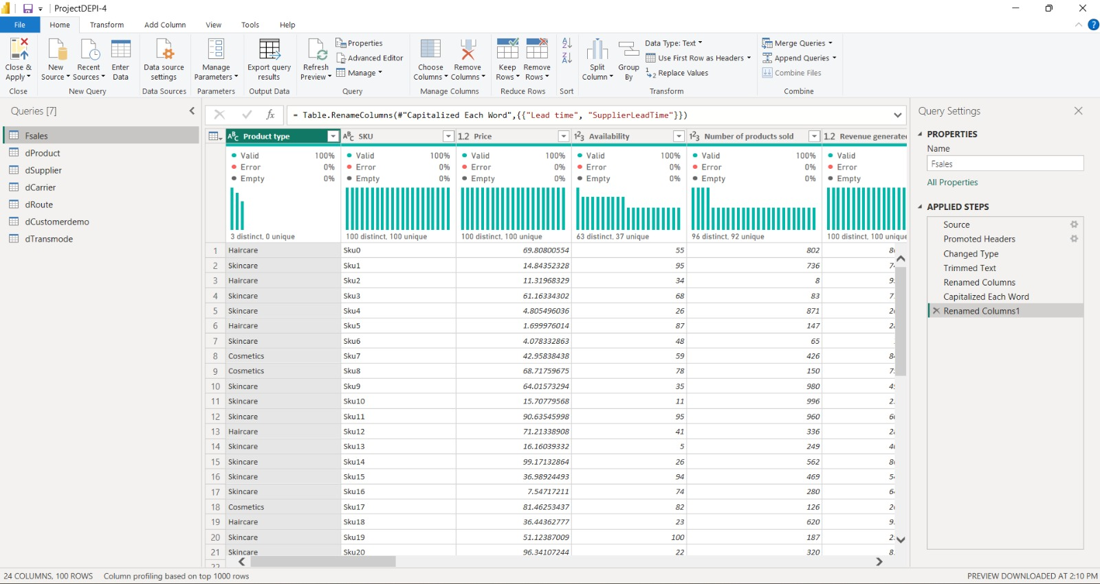
Applied Steps

Slide 11
Financial DAX
Quality & KPI DAX
AVg shipping costs = AVERAGE(Fsales[Shipping costs])
Avr man.cost.producttype = AVERAGEX(VALUES(dProduct[Product type]),
CALCULATE(AVERAGE(Fsales[Manufacturing costs])))
Cost Per Unit = [Total Cost] / [Total Production Vol]
Profit = [Total Revenue] - [Total Cost]
Revenue by Category = CALCULATE([Total Revenue],ALLSELECTED(dProduct[Product type]))
shipping cost Total = SUM(Fsales[Shipping costs])
Total Cost = SUM(Fsales[Costs]) + SUM(Fsales[Manufacturing costs]) + SUM(Fsales[Shipping costs])
Total Revenue = SUM(Fsales[Revenue generated])
1st Pass Yield = CALCULATE(COUNTROWS(Fsales) , Fsales[Inspection results] = "PASS")
Avg Defect Rate = AVERAGE(Fsales[Defect Rate%])
Defect Rate by Supplier = CALCULATE([Avg Defect Rate],ALLEXCEPT(Fsales,Fsales[Supplier name]))
Failed Inspections = CALCULATE(COUNTROWS(Fsales),Fsales[Inspection results]="Fail")
LeadManufTime vs Defect =
VAR ML = AVERAGE(Fsales[Manufacturing lead time])
VAR DR = AVERAGE(Fsales[Defect rates])
RETURN
ML * DR

Slide 12
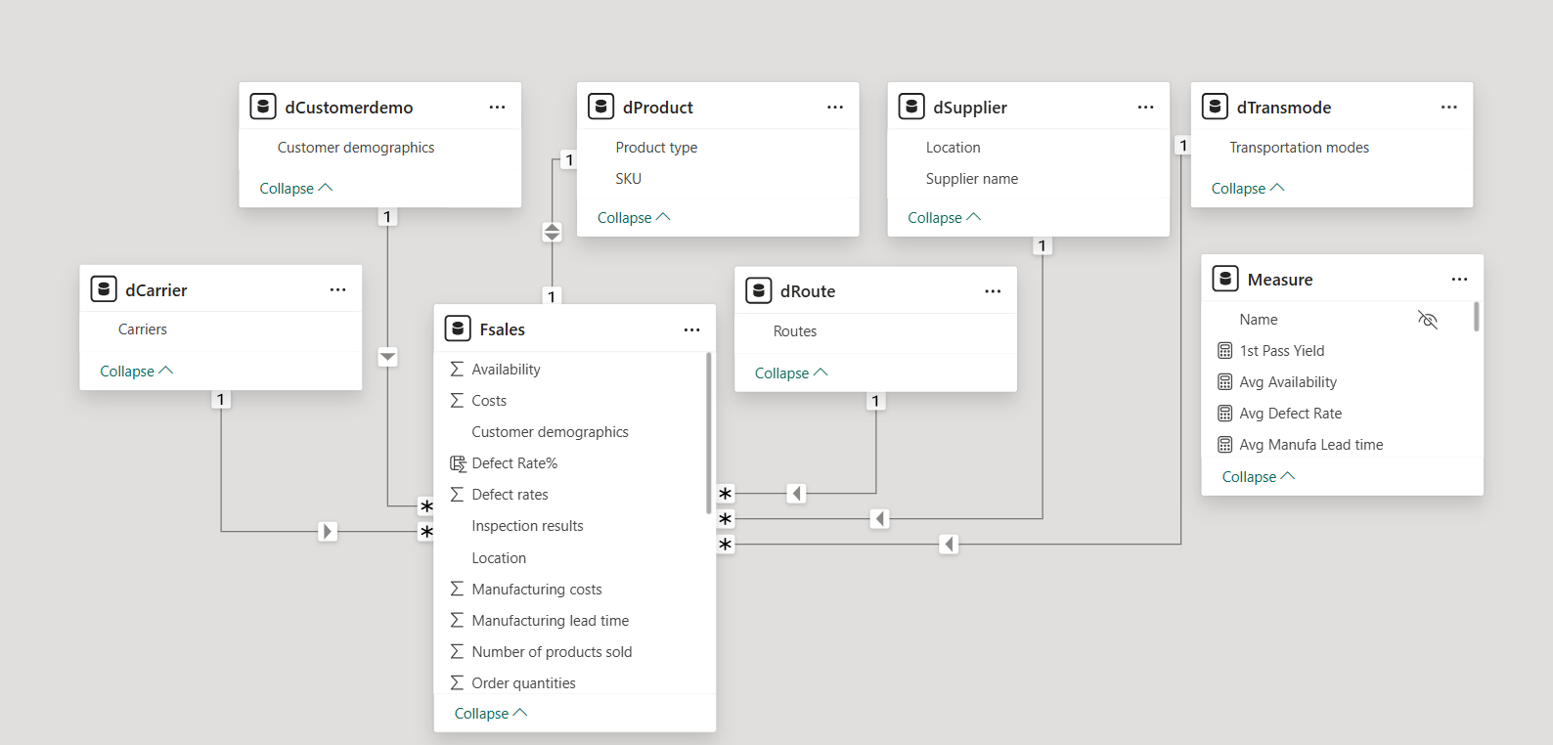
Data Model View

Slide 13
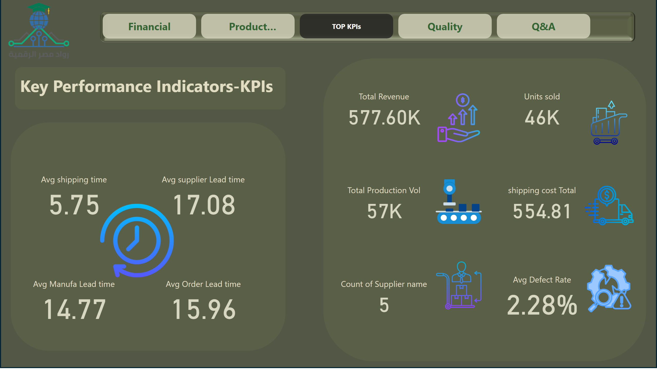
TOP KPIs
Notes:
cardVisual
No alt text provided
cardVisual
No alt text provided
pageNavigator
No alt text provided
textbox
No alt text provided

Slide 14
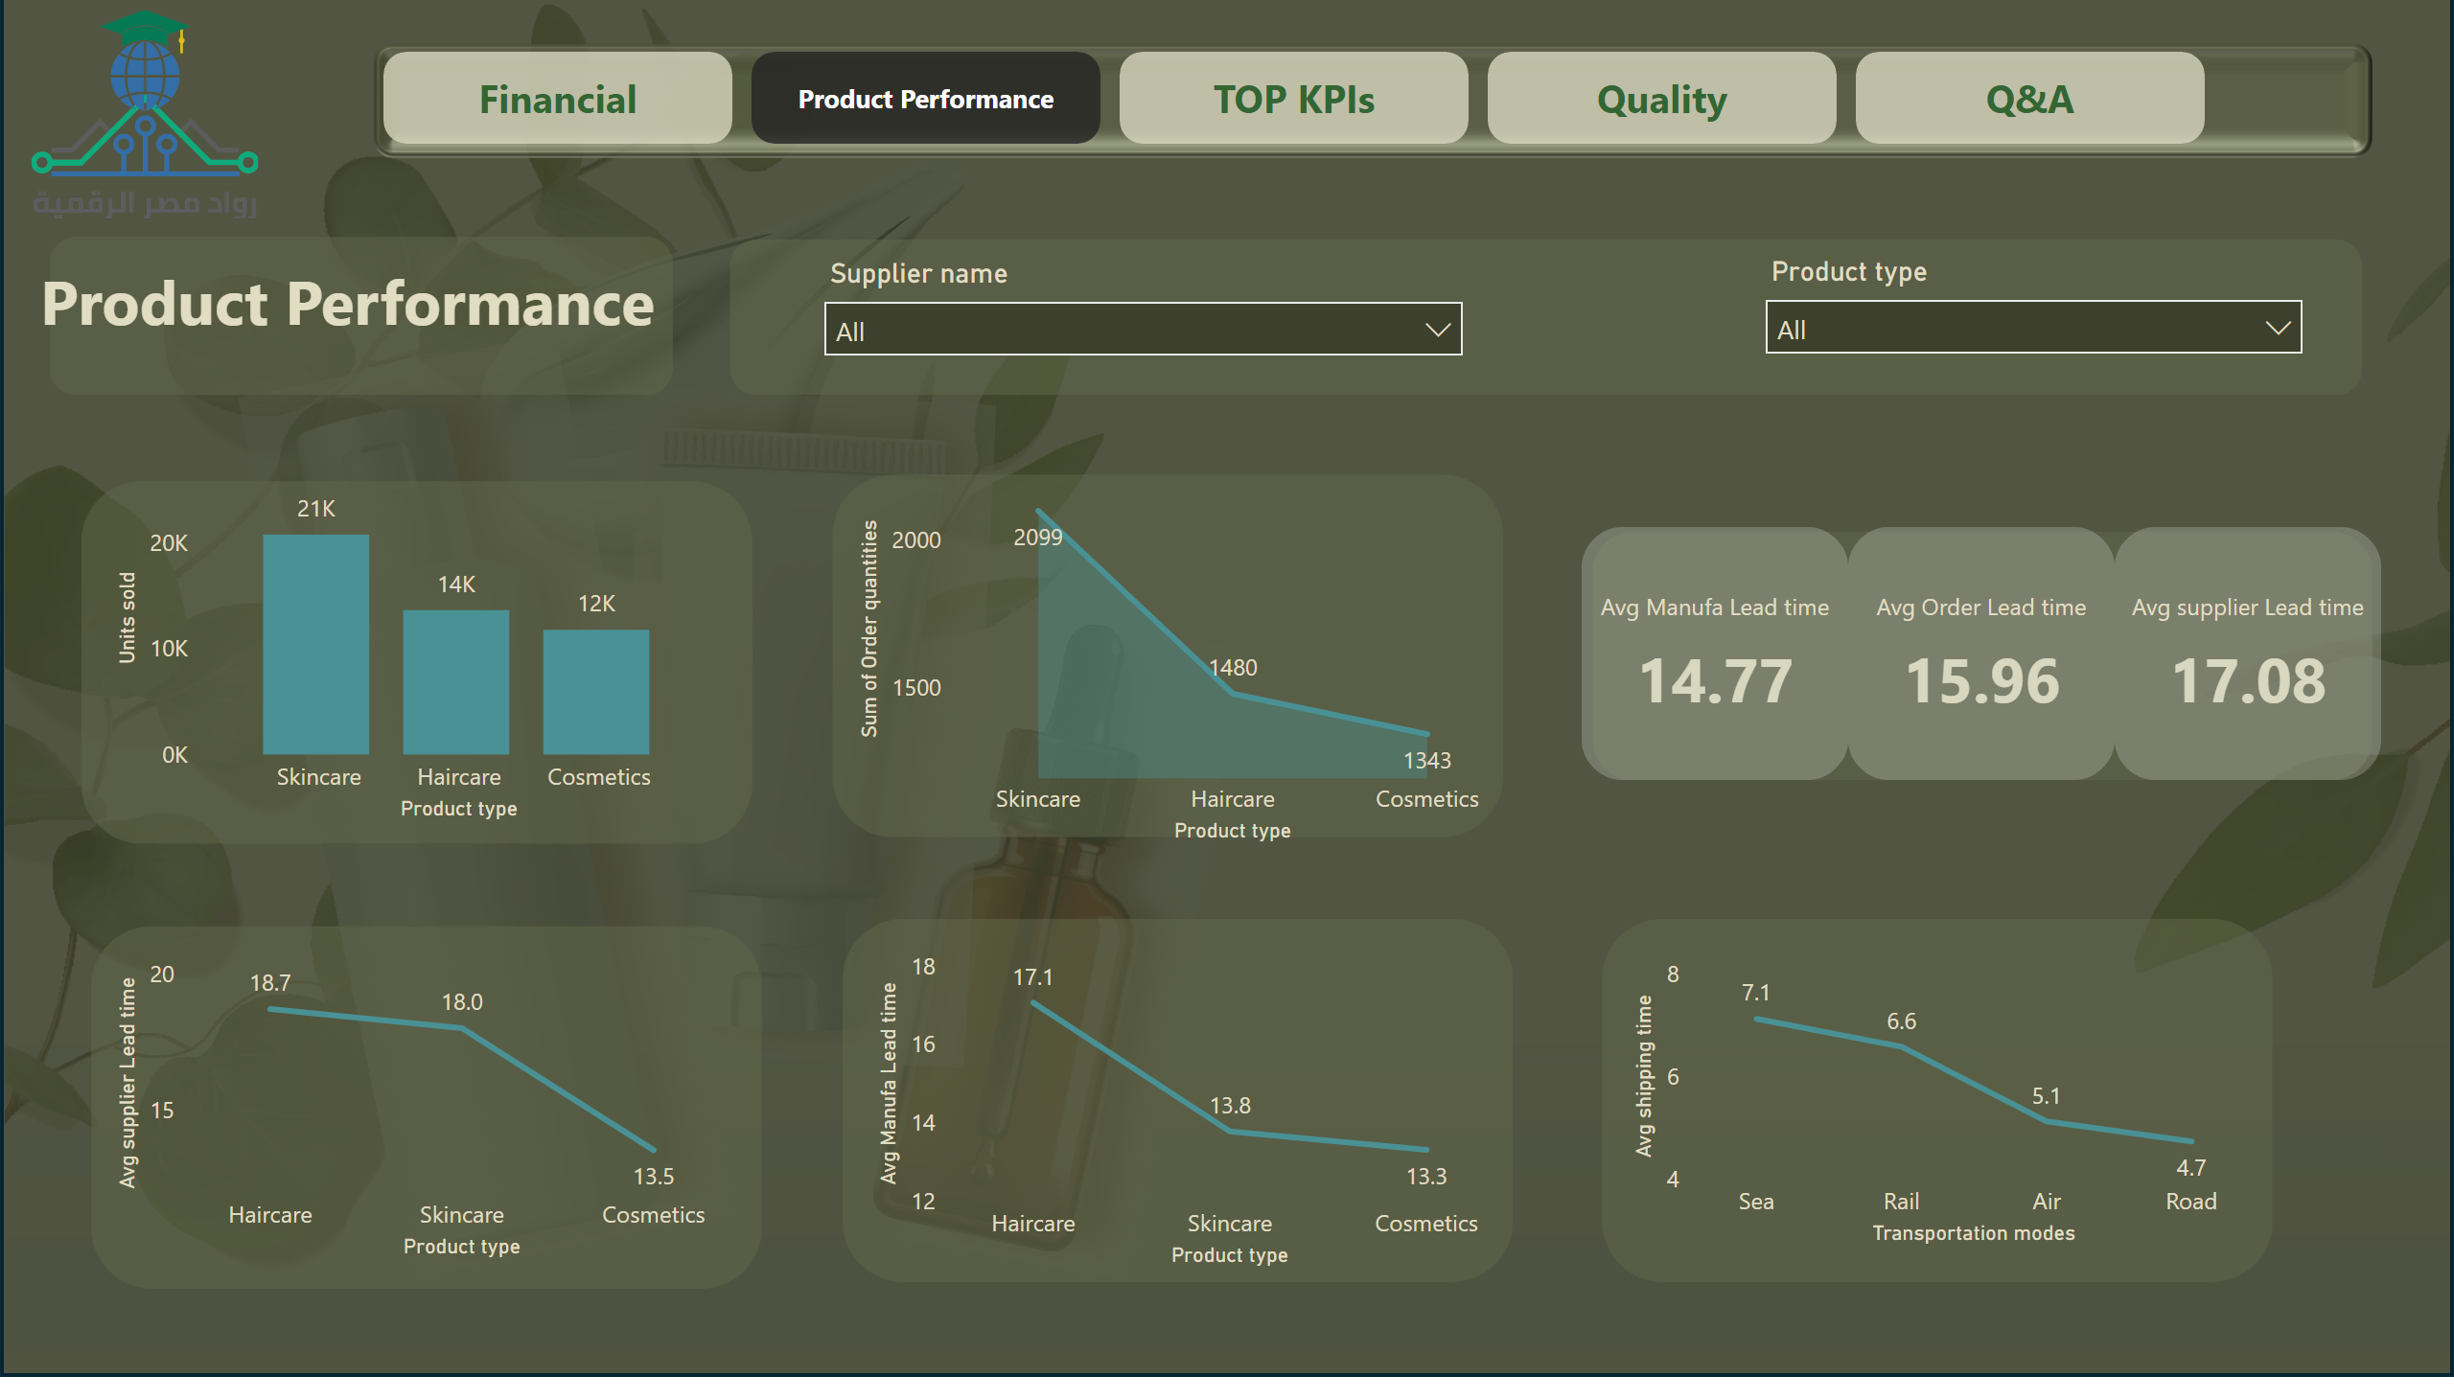
Product Performance
Notes:
areaChart
No alt text provided
SKU10, SKU94 و SKU9 تسيطر على جزء كبير من الأداء، ويجب إدارتها كـ Strategic Items (A Class)
textbox
No alt text provided
cardVisual
No alt text provided
lineChart
No alt text provided
lineChart
No alt text provided
clusteredColumnChart
No alt text provided
pageNavigator
No alt text provided
lineChart
No alt text provided
slicer
No alt text provided
slicer
No alt text provided

Slide 15
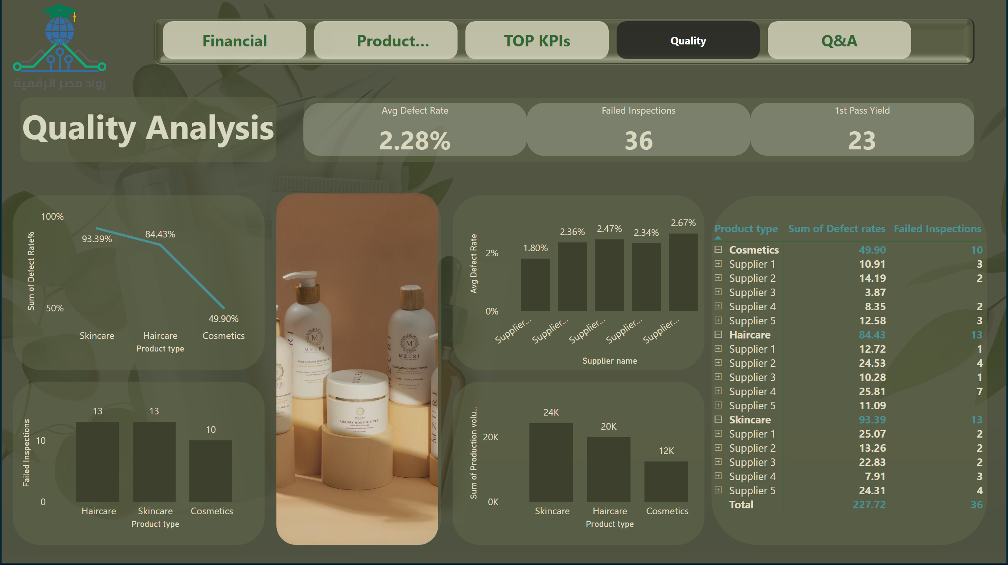
Quality
Notes:
clusteredColumnChart
No alt text provided
SKU10, SKU94 و SKU9 تسيطر على جزء كبير من الأداء، ويجب إدارتها كـ Strategic Items (A Class)
textbox
No alt text provided
cardVisual
No alt text provided
lineChart
No alt text provided
columnChart
No alt text provided
clusteredColumnChart
No alt text provided
pivotTable
No alt text provided
pageNavigator
No alt text provided
image
No alt text provided

Slide 16
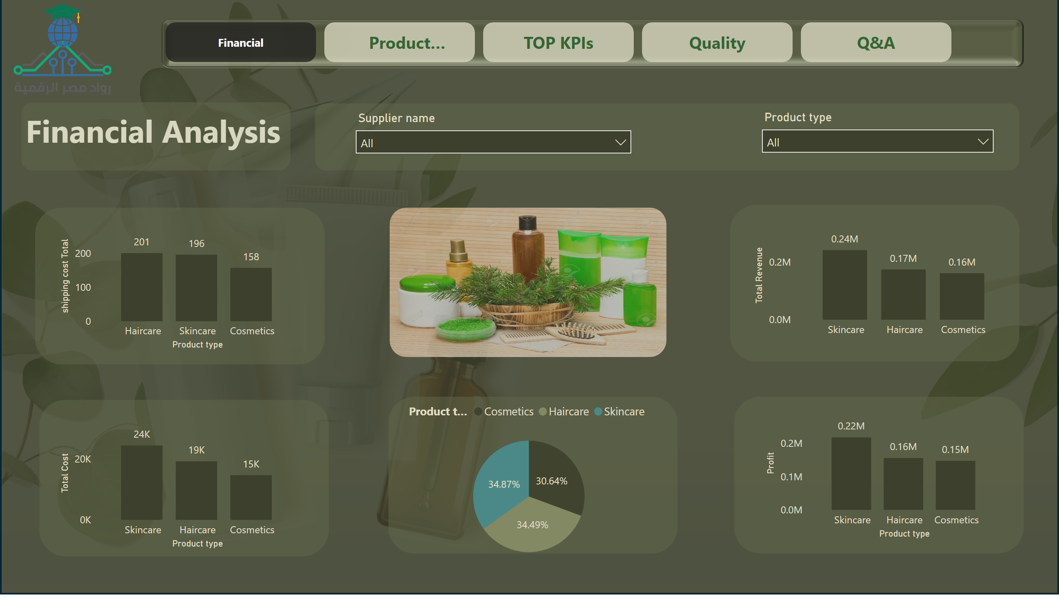
Financial
Notes:
clusteredColumnChart
No alt text provided
pieChart
No alt text provided
clusteredColumnChart
No alt text provided
columnChart
No alt text provided
clusteredColumnChart
No alt text provided
slicer
No alt text provided
slicer
No alt text provided
textbox
No alt text provided
image
No alt text provided
pageNavigator
No alt text provided

Slide 17
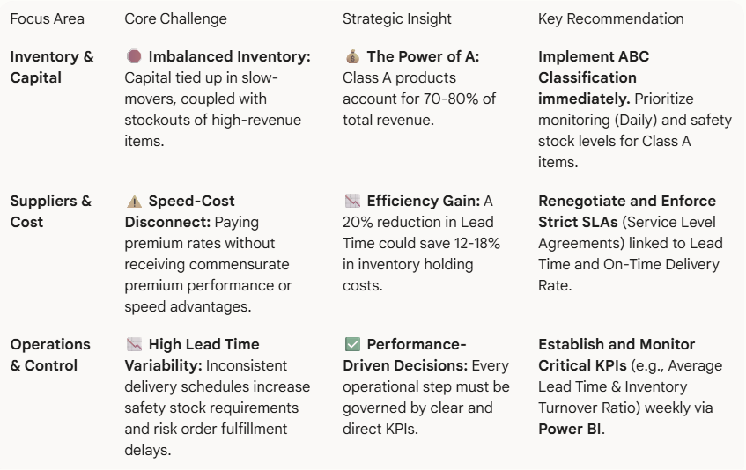
Conclusion

Slide 18
Q & A
Thank you

